Slide 1
Module 5
Text Mining

Slide 2
Text Mining
Text mining has become an increasingly popular and essential theme in data mining.
Users need tools to compare different documents, rank the importance and relevance of the documents, or find patterns and trends across multiple documents.

Slide 3
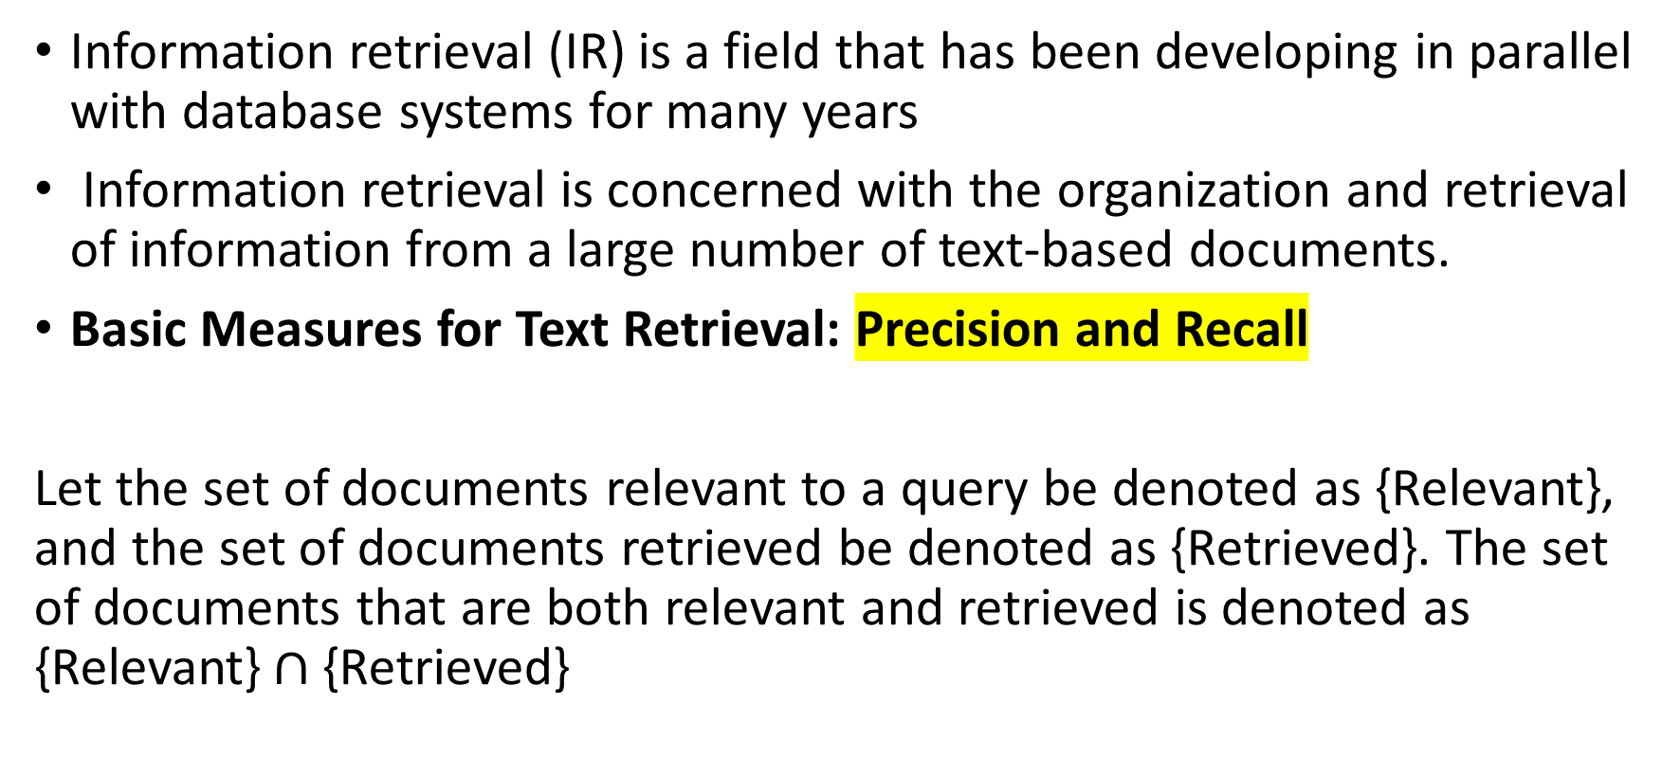
Text Data Analysis and Information Retrieval
Information retrieval (IR) is a field that has been developing in parallel with database systems for many years
Information retrieval is concerned with the organization and retrieval of information from a large number of text-based documents.
Basic Measures for Text Retrieval: Precision and Recall
Let the set of documents relevant to a query be denoted as {Relevant}, and the set of documents retrieved be denoted as {Retrieved}. The set of documents that are both relevant and retrieved is denoted as {Relevant}$∩${Retrieved}

Slide 4
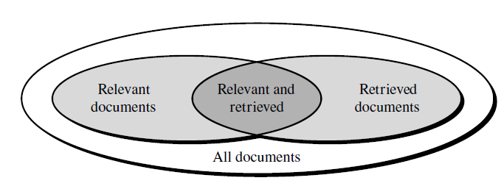

Slide 5

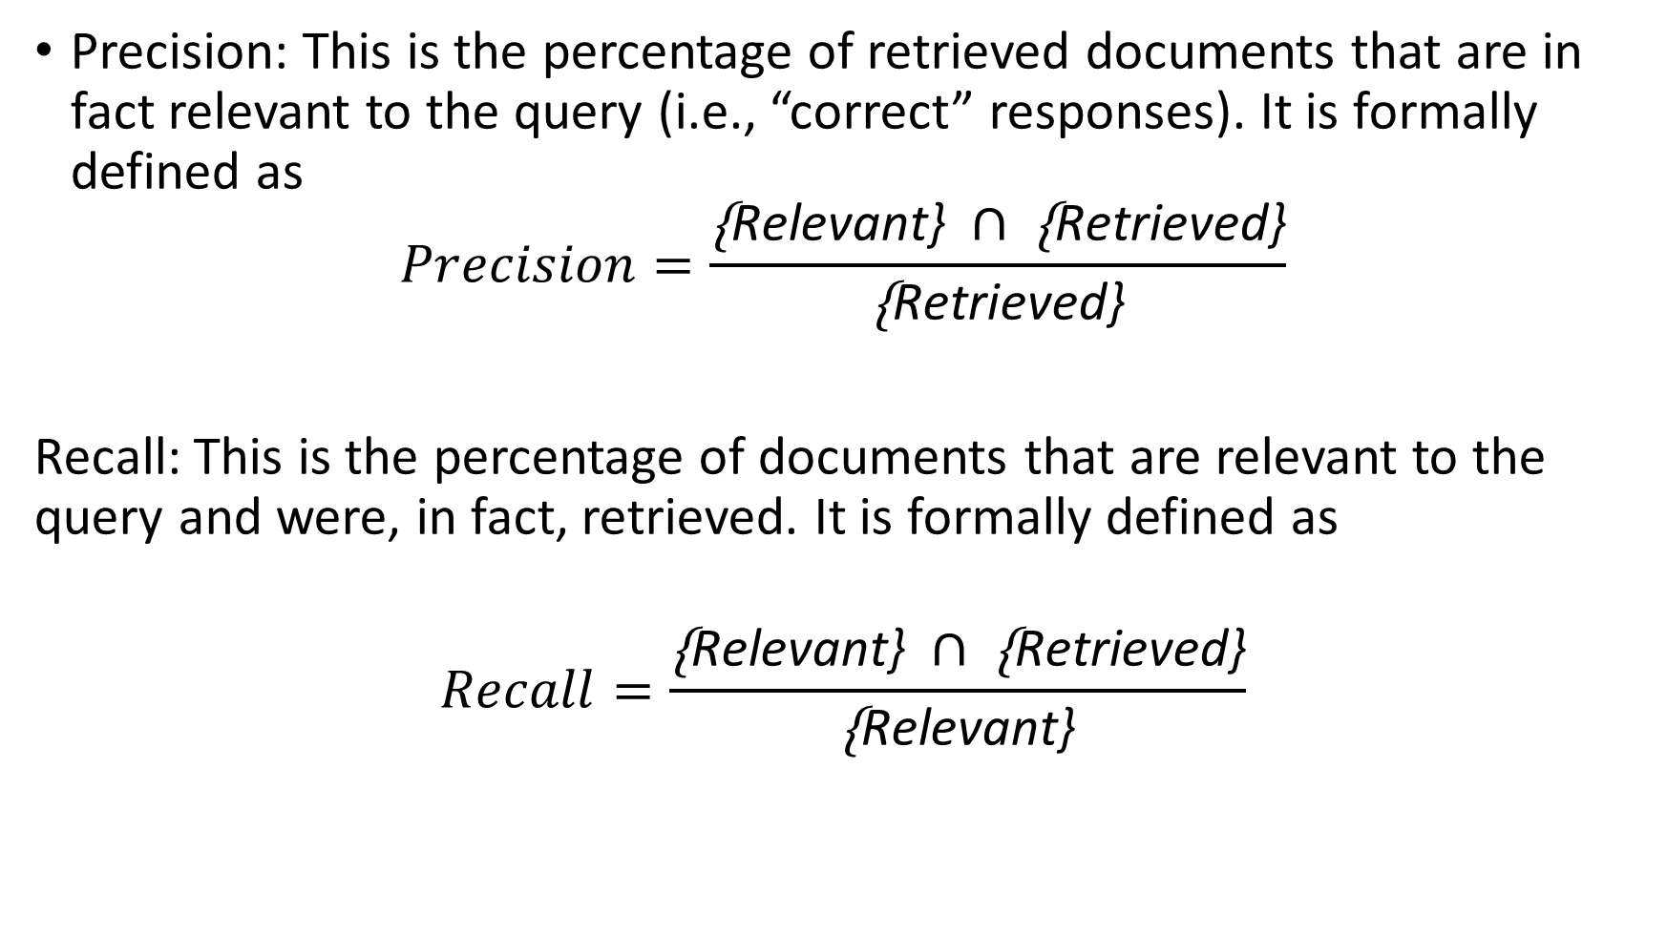
Precision: This is the percentage of retrieved documents that are in fact relevant to the query (i.e., “correct” responses). It is formally defined as
$$Precision=\frac{\text{\{}\text{Relevant}\text{\} }∩\text{ \{}\text{Retrieved}\text{\}}}{\text{\{}\text{Retrieved}\text{\}}}$$
Recall: This is the percentage of documents that are relevant to the query and were, in fact, retrieved. It is formally defined as
$$Recall=\frac{\text{\{}\text{Relevant}\text{\} }∩\text{ \{}\text{Retrieved}\text{\}}}{\text{\{}\text{Re}\text{levant}\text{\}}}$$

Slide 6
Text Retrieval Methods
Retrieval methods fall into two categories:
Document selection problem
Document ranking problem.

Slide 7
Document selection problem
In document selection methods, the query is regarded as specifying constraints for selecting relevant documents.
A typical method of this category is the Boolean retrieval model, in which a document is represented by a set of keywords and a user provides a Boolean expression of keywords, such as “car and repair shops,” “tea or coffee,” or “database systems but not Oracle.”

Slide 8
Document ranking problem
Document ranking methods use the query to rank all documents in the order of relevance.
For ordinary users and exploratory queries, these methods are more appropriate than document selection methods.
Most modern information retrieval systems present a ranked list of documents in response to a user’s keyword query.
There are many different ranking methods

Slide 9
Vector space model.
Most popular approach for information retrieval.
The basic idea of the vector space model is the following: We represent a document and a query both as vectors in a high-dimensional space corresponding to all the keywords and use an appropriate similarity measure to compute the similarity between the query vector and the document vector.
The similarity values can then be used for ranking documents.

Slide 10
Tokenization: The first step in most retrieval systems is to identify keywords for representing documents, a preprocessing step often called tokenization.
Stop list: To avoid indexing useless words, a text retrieval system often associates a stop list with a set of documents. A stop list is a set of words that are deemed “irrelevant.” For example, a, the, of, for, with, and so on are stop words.
Word Stem: A group of different words may share the same word stem, where the words in a group are small syntactic variants of one another and collect only the common word stem per group. For example, the group of words drug, drugged, and drugs, share a common word stem, drug.

Slide 11
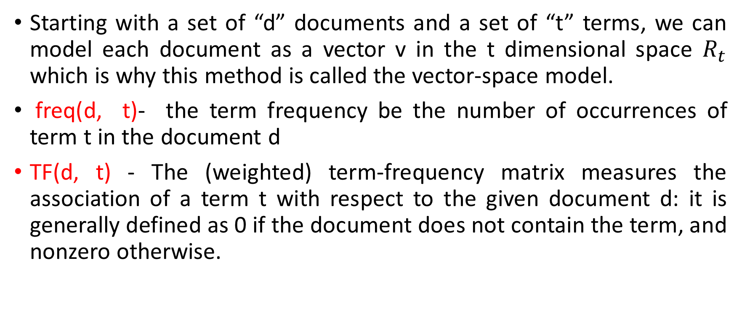
“How can we model a document to facilitate information retrieval?”
Starting with a set of “d” documents and a set of “t” terms, we can model each document as a vector v in the t dimensional space $R_{t}$ which is why this method is called the vector-space model.
freq(d, t)- the term frequency be the number of occurrences of term t in the document d
TF(d, t) - The (weighted) term-frequency matrix measures the association of a term t with respect to the given document d: it is generally defined as 0 if the document does not contain the term, and nonzero otherwise.

Slide 12


Cornell SMART system uses the following formula to compute the (normalized) term frequency:
Inverse document frequency (IDF), that represents the scaling factor, or the importance, of a term t. If a term t occurs in many documents, its importance will be scaled down due to its reduced discriminative power.
where d is the document collection, and dt is the set of documents containing term t.

Slide 13

In a complete vector-space model, TF and IDF are combined together, which forms the TF-IDF measure:

Slide 14

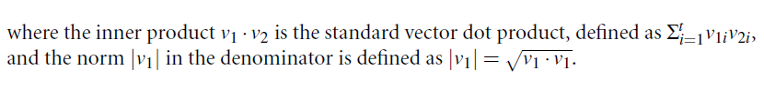
“How can we determine if two documents are similar?”
A representative metric is the cosine measure, defined as follows.
Let v1 and v2 be two document vectors. Their cosine similarity is defined as

Slide 15
Text Indexing Techniques
There are several popular text retrieval indexing techniques, including inverted indices and signature files.
An inverted index is an index structure that maintains two hash indexed or B+-tree indexed tables: document_table and term_table,

Slide 16
Document_table consists of a set of document records, each containing two fields: doc_id and posting_list, where posting list is a list of terms (or pointers to terms) that occur in the document, sorted according to some relevance measure.
Term_table consists of a set of term records, each containing two fields: term id and posting list, where posting list specifies a list of document identifiers in which the term appears.

Slide 17
A signature file is a file that stores a signature record for each document in the database.
Each signature has a fixed size of b bits representing terms.
A simple encoding scheme goes as follows.
Each bit of a document signature is initialized to 0.
A bit is set to 1 if the term it represents appears in the document.
A signature S1 matches another signature S2 if each bit that is set in signature S2 is also set in S1.

Slide 18
Query Processing Techniques
Once an inverted index is created for a document collection, a retrieval system can answer a keyword query quickly by looking up which documents contain the query keywords.
When examples of relevant documents are available, the system can learn from such examples to improve retrieval performance.
This is called relevance feedback and has proven to be effective in improving retrieval performance.

Slide 19
When we do not have such relevant examples, a system can assume the top few retrieved documents in some initial retrieval results to be relevant and extract more related keywords to expand a query.
Such feedback is called pseudo-feedback or blind feedback.
One major limitation of many existing retrieval methods is that they are based on exact keyword matching.
Due to the complexity of natural languages, keyword based retrieval can encounter two major difficulties.

Slide 20
The first is the synonymy problem: two words with identical or similar meanings may have very different surface forms.
For example, a user’s query may use the word “automobile,” but a relevant document may use “vehicle” instead of “automobile.”
The second is the polysemy problem: the same keyword, such as mining, or Java, may mean different things in different contexts.

